Slide 1
Query Languages
Lecture 11

Slide 2
Procedural v/s Non-procedural Query
Query Language
Relational Algebra
Procedural Query
Tuple Relational Calculus
Non-Procedural Query
SQL
Procedural Query Language involves formulation of “what to retrieve” and “how to retrieve” data by providing a logical step-by-step process.
Non-Procedural Query Language involves formulation of only “what to retrieve” from the data. Only the output is important not the procedure or steps.

Slide 3
Relational algebra
Basic Operators
Projection (π)
Derived Operators
Intersection (∩)
Join (⋈)
Division (/)
Rename (ρ)
Set Difference (-)
Union (∪)
Cartesian Product (X)
Selection (σ)

Slide 4
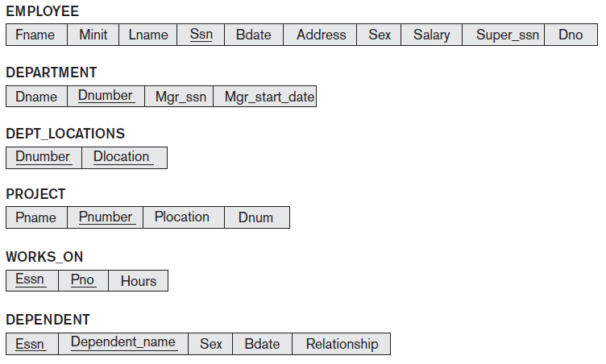
COMPANY Database

Slide 5


Unary Relational Operations: Select, Project, Rename
SELECT Operation
Extracts subset of the tuples from a relation that satisfies a selection condition:
The selection condition (Boolean expression) contains clauses of the form:
<attribute name> <comparison op> <constant value>
or
<attribute name> <comparison op> <attribute name>
It is a filter that keeps only those tuples that satisfy the qualifying/selection condition and discards the others.

Slide 6
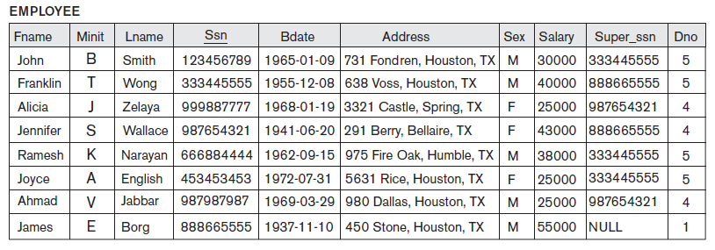

Select Operator Example
Select the EMPLOYEE tuples whose department number is 4.
Query: σDNO = 4 (EMPLOYEE)
Output:

Slide 7
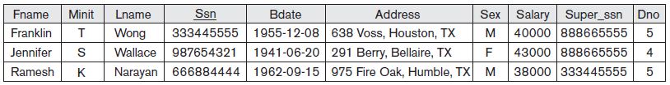
Select Operator Example
Select the tuples for all employees who either work in department 4 and make over $25,000 per year, or work in department 5 and make over $30,000
Query:
Output:

Slide 8
Select Operation Properties
The SELECT operation σ _{<selection condition>}(R) produces a relation S that has the same schema as R.
The SELECT operation σ is commutative; i.e.,
σ _{<condition1>}(σ _{< condition2>} ( R)) = σ _{<condition2>} (σ _{< condition1>} ( R))
A cascaded SELECT operation may be applied in any order; i.e.,
σ _{<condition1>}(σ _{< condition2>} (σ _{<condition3>} ( R))
= σ _{<condition2>} (σ _{< condition3>} (σ _{< condition1>} ( R)))
A cascaded SELECT operation may be replaced by a single selection with a conjunction of all the conditions; i.e.,
σ _{<condition1>}(σ _{< condition2>} (σ _{<condition3>} ( R))
= σ <condition1> AND < condition2> AND < condition3> ( R)))

Slide 9


Project Operation
This operation selects certain columns from the table and discards the other columns.
The PROJECT creates a vertical partitioning – one with the needed columns (attributes) containing results of the operation and other containing the discarded Columns.
Result of PROJECT operation is a set of distinct tuples.

Slide 10
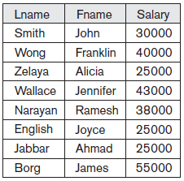
Project Operator Example
List each employee’s first and last name and salary.
Query: π_{LNAME, FNAME,SALARY} (EMPLOYEE)
Output:

Slide 11
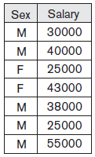
Project Operator Example
List each employee’s first and last name and salary.
Query: π_{SEX, SALARY} (EMPLOYEE)
Output:
Duplicate tuples eliminated

Slide 12


Rename Operation
To apply several relational algebra operations one after the other, either we can write the operations as a single relational algebra expression by nesting the operations, or we can apply one operation at a time and create intermediate result relations. In the latter case, we must give names to the relations that hold the intermediate results.
The general Rename operation can be expressed by any of the following forms:
ρ _{S (B1, B2, …, Bn )} ( R) is a renamed relation S based on R with column names B₁, B₂…..B_{n}.
ρ _{S} ( R) is a renamed relation S based on R (which does not specify column names).

Slide 13
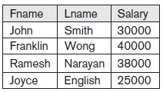
Rename Operator Example
Retrieve the first name, last name, and salary of all employees who work in department number 5.
Query: π_{FNAME, LNAME, SALARY}(σ _{DNO=5}(EMPLOYEE))
or
DEP5_EMPS ← σ _{DNO=5}(EMPLOYEE)
RESULT ← π _{FNAME, LNAME, SALARY} (DEP5_EMPS)
Output:

Slide 14

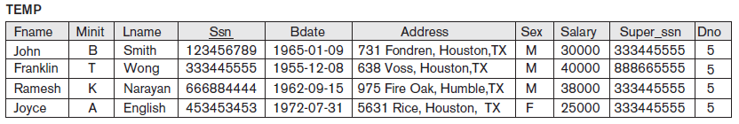
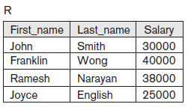
Rename Operator Example
Retrieve the first name, last name, and salary of all employees who work in department number 5.
Query: π_{FNAME, LNAME, SALARY}(σ _{DNO=5}(EMPLOYEE))
or
Output:

Slide 15

Cartesian (or Cross) Product Operation
This operation is used to combine tuples from two relations in a combinatorial fashion.
In general, the result of R(A₁, A₂, . . ., A_{n}) X S(B₁, B₂, . . ., B_{m}) is a relation Q with degree n + m attributes Q(A₁, A₂, . . ., A_{n}, B₁, B₂, . . ., B_{m}), in that order.
The resulting relation Q has one tuple for each combination of tuples—one from R and one from S.
Hence, if R has n_{R} tuples (denoted as |R| = n_{R} ),
and S has n_{S} tuples, then
| R x S | will have n_{R} * n_{S} tuples.

Slide 16
Note: The two operands do NOT have to be "type compatible”
What is Type Compatible?
The operand relations R₁(A₁, A₂, ..., A_{n}) and R₂(B₁, B₂, ..., B_{n}) must have the same number of attributes, and the domains of corresponding attributes must be compatible; that is, dom(A_{i})=dom(B_{i}) for i=1, 2, ..., n.

Slide 17
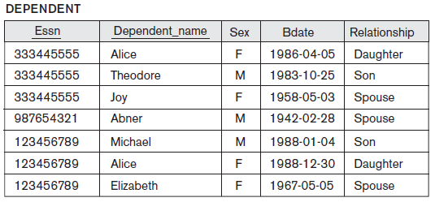
Cartesian (or Cross) Product Operation Example

Slide 18
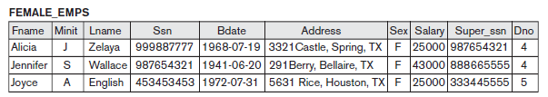
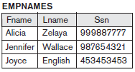
Cartesian (or Cross) Product Operation Example
To retrieve a list of names of each female employee’s dependents
Query:
FEMALE_EMPS ← σ_{Sex=‘F}’(EMPLOYEE)
EMPNAMES ← π_{Fname, Lname, Ssn}(FEMALE_EMPS)

Slide 19
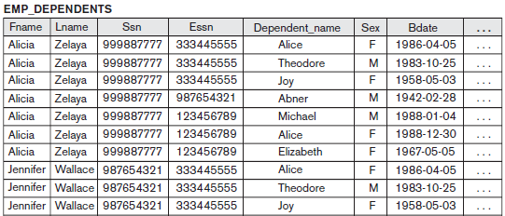
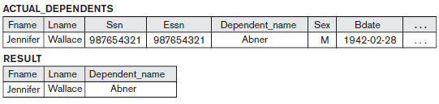
Cartesian (or Cross) Product Operation Example
EMP_DEPENDENTS ← EMPNAMES × DEPENDENT
ACTUAL_DEPENDENTS ← σ_{Ssn=Essn}(EMP_DEPENDENTS)
RESULT ← π_{Fname, Lname, Dependent_name} (ACTUAL_DEPENDENTS)

Slide 20

Union Operation
The result of this operation, denoted by R ∪ S, is a relation that includes all tuples that are either in R or in S or in both R and S.
The operand relations R₁(A₁, A₂, ..., A_{n}) and R₂(B₁, B₂, ..., B_{n}) must have the same number of attributes, and the domains of corresponding attributes must be compatible; that is, dom(A_{i})=dom(B_{i}) for i=1, 2, ..., n.
Duplicate tuples are automatically eliminated.

Slide 21
Union Operator Example
To retrieve the social security numbers of all employees who either work in department 5 or directly supervise an employee who works in department 5.
Query: DEP5_EMPS ← σ_{DNO=5} (EMPLOYEE)
RESULT1 ← π _{SSN}(DEP5_EMPS)
RESULT2(SSN) ← π _{SUPERSSN}(DEP5_EMPS)
RESULT ← RESULT1 ∪ RESULT2

Slide 22
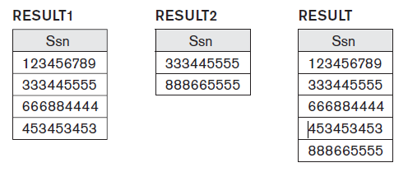
Another way to write the same query:
Result ← π_{Ssn} (σ_{Dno=5} (EMPLOYEE) ) ∪
π_{Super_ssn} (σ_{Dno=5} (EMPLOYEE))
Output:

Slide 23
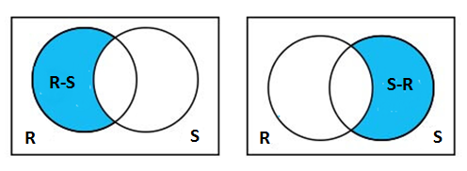
Set Difference (or Minus) Operation
The result of this operation, denoted by R - S, is a relation that includes all tuples that are in R but not in S.
The two operands must be "type compatible”.

Slide 24
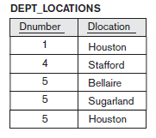
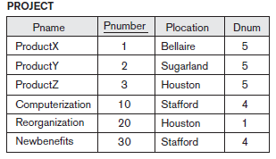
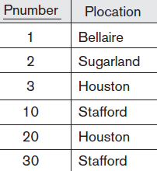
Set Difference (or Minus) Operation Example
Query:
PROJECT_SUBSET ← π _{Pnumber, Plocation} (PROJECT)
Result ← PROJECT_SUBSET – DEPT_LOCATIONS
Output:

Slide 25

JOIN Operation
Join is a derived operator that uses a sequence of cartesian product followed by selection of related tuples from two relations and then projection of distinct attributes. It is denoted by a ⋈.
This operation is very important for any relational database with more than a single relation, because it allows us to process relationships among relations.
The general form of a join operation on two relations R(A₁, A₂, . . ., A_{n}) and S(B₁, B₂, . . ., B_{m}) is:
R ⋈ _{<join condition>} S
where R and S can be any relations that result from general relational algebra expressions.

Slide 26
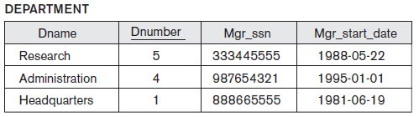
JOIN Operation Example

Slide 27
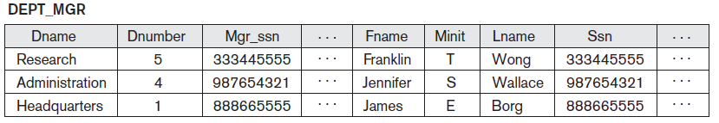
JOIN Operation Example Cont.
To retrieve the name of the manager of each department. To get the manager’s name, we need to combine each DEPARTMENT tuple with the EMPLOYEE tuple whose SSN value matches the MGRSSN value in the department tuple.
Query:
DEPT_MGR ← DEPARTMENT _{MGRSSN=SSN} EMPLOYEE
Output:

Slide 28
JOIN Operation Example
EMP_DEPENDENTS ← EMPNAMES × DEPENDENT
ACTUAL_DEPENDENTS ← σ_{Ssn=Essn}(EMP_DEPENDENTS)
= = = = = = = = = =
ACTUAL_DEPENDENTS← EMPNAMES _{Ssn=Essn} DEPENDENT

Slide 29
Variations of Join Operation (Inner Joins)
EQUIJOIN Operation
The most common use of join involves join conditions with equality comparisons only. Such a join, where the only comparison operator used is =, is called an EQUIJOIN.
In the result of an EQUIJOIN we always have one or more pairs of attributes (whose names need not be identical) that have identical values in every tuple.
NATURAL JOIN Operation
Because one of each pair of attributes with identical values is superfluous, a new operation called natural join—denoted by *—was created to get rid of the second (superfluous) attribute in an EQUIJOIN condition.
Natural join requires that the two join attributes, or each pair of corresponding join attributes, have the same name in both relations. If this is not the case, a renaming operation is applied first.

Slide 30
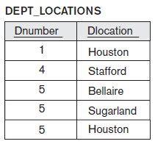
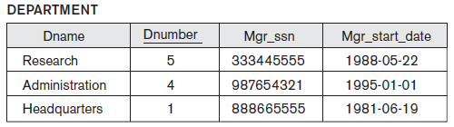
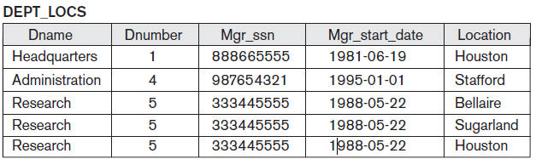
Natural Join Example
Query:
DEPT_LOCS ← DEPARTMENT * DEPT_LOCATIONS
Output:

Slide 31
Inner Joins
Note: NATURAL JOIN is basically an EQUIJOIN followed by the removal of the superfluous attributes.
The NATURAL JOIN or EQUIJOIN operation can also be specified among multiple tables, leading to an n-way join
Example:
((PROJECT _{Dnum=Dnumber}DEPARTMENT) _{Mgr_ssn=Ssn}EMPLOYEE)
Each project tuple is combined with its controlling department tuple into a single tuple, and then that tuple is combined with an employee tuple that is the department manager. The net result is a consolidated relation in which each tuple contains this project-department-manager combined information.

Slide 32
Relational Algebra Operators
Operation | Purpose | Notation
SELECT | Selects all tuples that satisfy the selection condition from a relation R. | σ<selection condition>(R)
PROJECT | Produces a new relation with only some | π<attribute list>(R)
CARTESIAN/ CROSS PRODUCT | Produces a relation that has the attributes of R1 and R2 and includes as tuples all possible combinations of tuples from R1 and R2. | R1 × R2
UNION | Produces a relation that includes all the tuples in R1 or R2 or both R1 and R2; R1 and R2 must be union compatible. | R1 ∪ R2
SET-DIFFERENCE/ MINUS | Produces a relation that includes all the tuples in R1 that are not in R2; R1 and R2 must be union compatible. | R1 – R2

Slide 33
Relational Algebra Operators Cont.
Operation | Purpose | Notation
EQUIJOIN | Produces all the combinations of tuples from R1 and R2 that satisfy a join condition with only equality comparisons. | R1 _{<join condition>} R2, OR R1 _{(<join attributes 1>),} _{(<join attributes 2>)} R2
NATURAL JOIN | Same as EQUIJOIN except that the join attributes of R2 are not included in the resulting relation; if the join attributes have the same names, they do not have to be specified at all. | R1 *_{<join condition>} R2, OR R1 * _{(<join attributes 1>),} _{(<join attributes 2>)} R2 OR R1 * R2
THETA JOIN | Produces all combinations of tuples from R1 and R2 that satisfy the join condition. | R1 _{<join condition>} R2

Slide 34


Slide 35
Question 1-2
Cross Product in relation algebra is a
Unary Operator
Binary Operator
Ternary Operator
Not defined
Relational Algebra is a __________ query language that takes two relation as input and produces another relation as output of the query.
Relational
Procedural
Structural
Fundamental

Slide 36

Answer 1-2
1. Answer: B
2. Answer: B

Slide 37
Question 3-4
Which of the following is used to denote the selection operation in relational algebra?
π
σ
α
ρ
A relational operator that yields values from all rows found in a table is known as the ____ operator.
Selection
Projection
Difference
Cross-product

Slide 38

Answer 3-4
3. Answer: A
4. Answer: A

Slide 39
Question 5
If relation A has 6 rows and 4 attributes and relation B has 3 rows and 2 attributes and the cartesian product operation was carried out on relation A and relation B, What would be the cardinaility of the new relation C where C = A X B?
12
6
24
18

Slide 40

Solution 5
5. Answer: D

Slide 41
BANK Database for Practice Queries
branch(branch_name, branch_city, assets)
customer (customer_name, customer_street, customer_city)
loan (loan_number, branch_name, amount)
borrower (customer_name, loan_number)
account (account_number, branch_name, balance)
depositor (customer_name, account_number)

Slide 42
Practice Queries on BANK Database
Find the names of all branches located in “Chicago”.
Find the names of all borrowers who have a loan in branch “Downtown”.
Find all loan numbers with a loan value greater than $10,000.
Find the names of all depositors who have an account with a value greater than $6,000.
Find the names of all depositors who have an account with a value greater than $6,000 at the “Uptown” branch.

Slide 43
UNIVERSITY Database for Practice Queries
Classroom (building, room_number, capacity)
Department (dept_name, building, budget)
Course (course_id, title, dept_name, credits)
Instructor (ID, name, dept_name, salary)
Section (course_id, sec_id, semester, year, building, room_number, time_slot_id)
Teaches (ID, course_id, sec_id, semester, year)
Student (ID, name, dept_name, tot_cred)
Takes (ID, course_id, sec_id, semester, year, grade)
Advisor (s_ID, i_ID)
Time _Slot (time slot_id, day, start_time, end_time)
Prereq (course_id, prereq_id)

Slide 44
Practice Queries on UNIVERSITY Database
What is the output of following expressions:
σ_{sid=I D}(student × advisor)
year≥2009(takes) student
year≥2009(takes student)
π_{ID,name,course id} (student takes)

Slide 45
Thanks!!

